Slide 1
Characterizing Running Times
Session 04
Nikita Ananda Putri Masaling, S.Kom., M.Kom.

Slide 2
Outline materials
Session 4
Asymptotic Notation: O, Ω, Θ
Common Functions and Their Growth Rates
Proving Bounds Formally and Informally
Comparing Algorithm Efficiency Using Asymptotic Notation

Slide 3
Learning Outcomes
Session 4
By the end of this session, students will be able to:
LO 1: Evaluate the time and space complexity of algorithms using asymptotic notation and formal analysis methods, and prove algorithm correctness using loop invariants, induction, or exchange arguments.

Slide 4
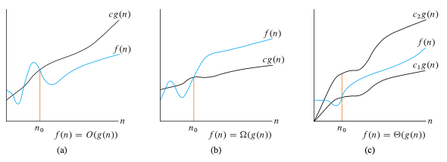
Asymptotic Notation: O, Ω, Θ
intro
Asymptotic notation characterizes the growth behaviour of functions as n → ∞, suppressing constant factors and lower-order terms.
We apply it to running times, space requirements, or any resource function.

Slide 5
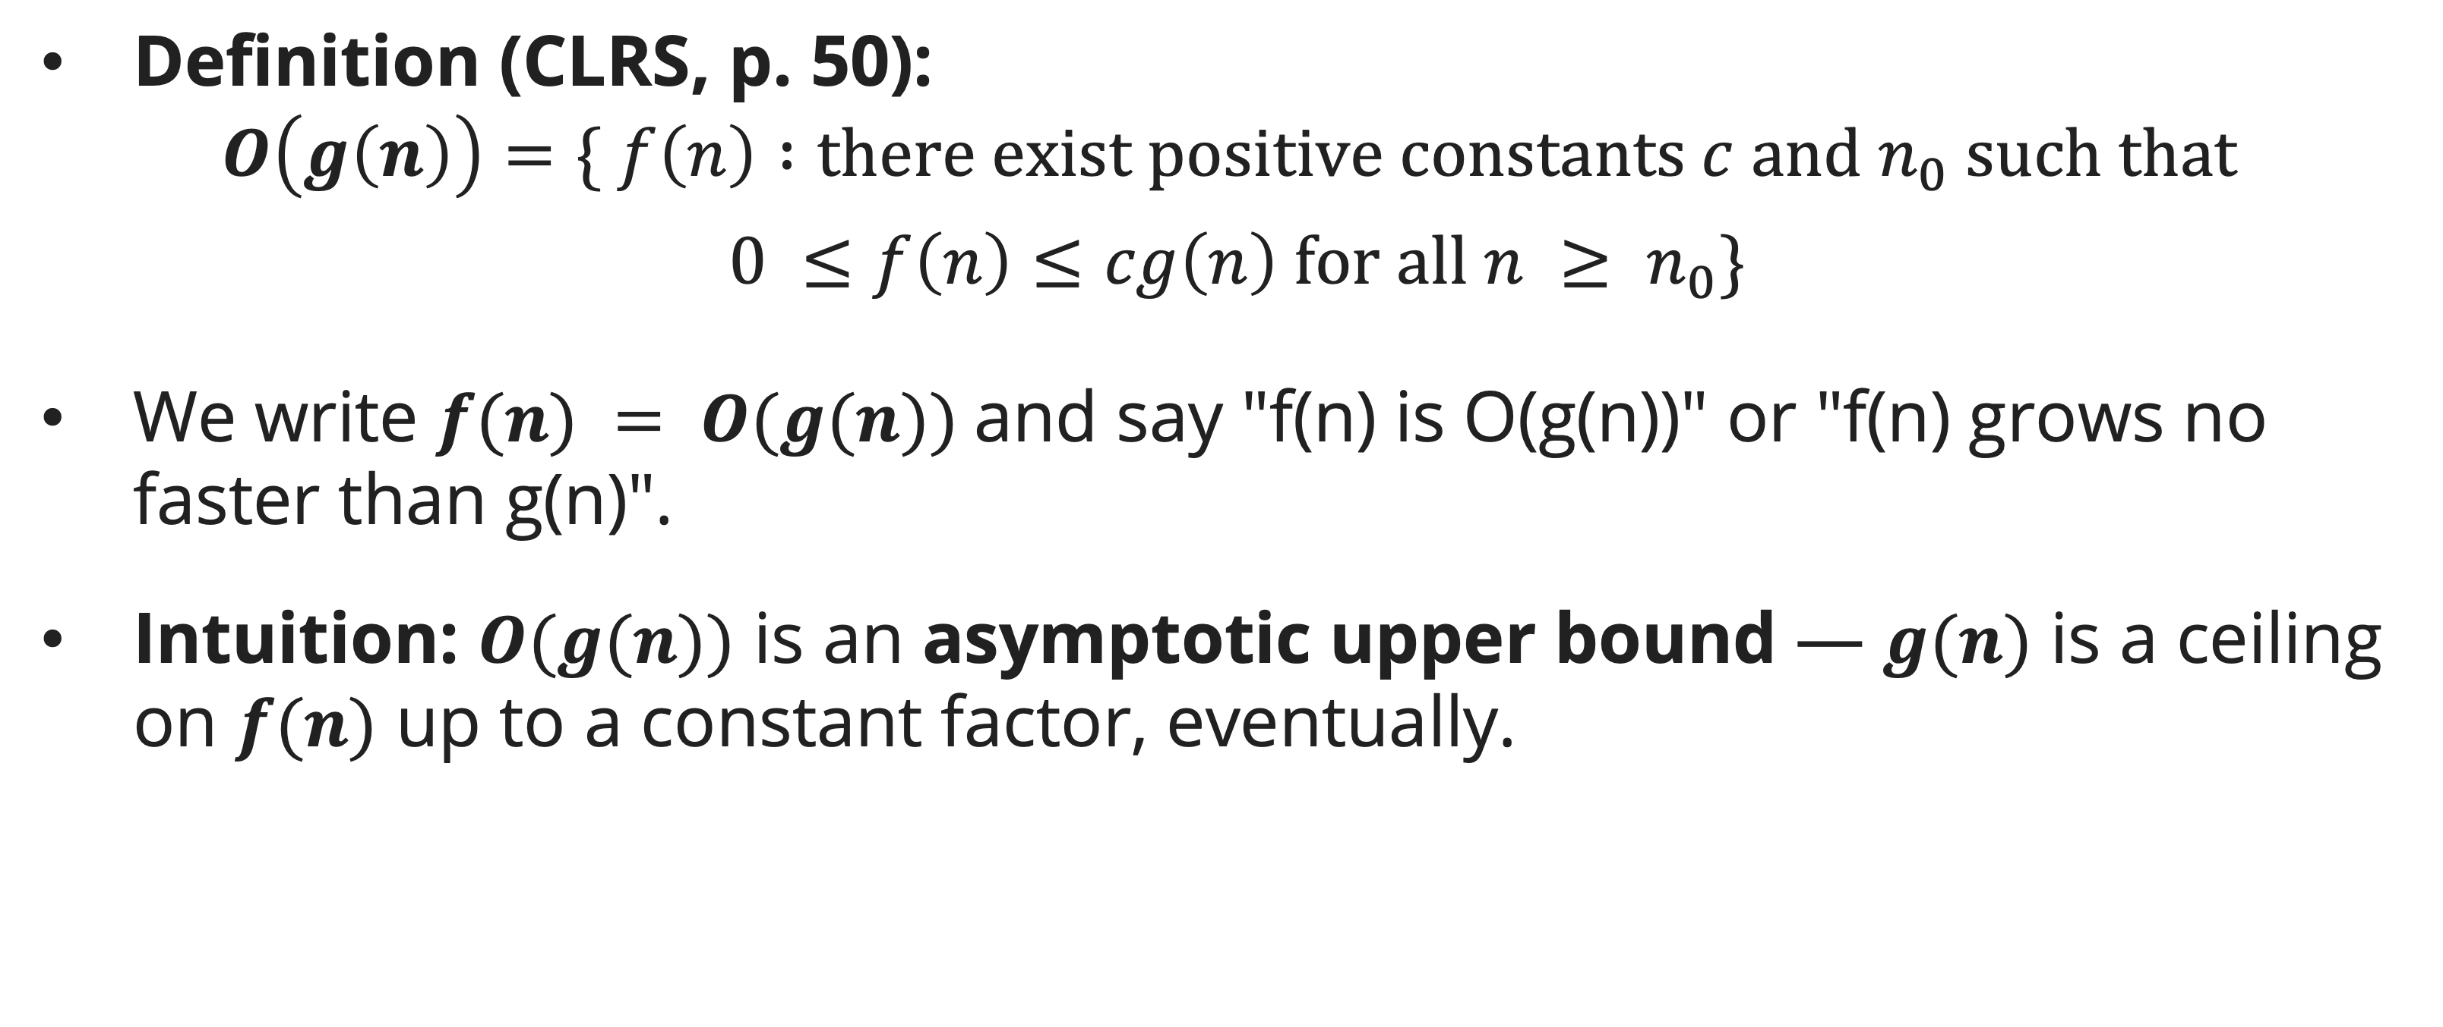
Asymptotic Notation: O, Ω, Θ
O-Notation (Asymptotic Upper Bound)
Definition (CLRS, p. 50):
$$Ο\left(g\left(n\right)\right)=\{ f\left(n\right) :there exist positive constants c and n_{0} such that$$
$$0 ≤f\left(n\right)≤cg\left(n\right) for all n ≥ n_{0}\}$$
We write $f(n) = O(g(n))$and say "f(n) is O(g(n))" or "f(n) grows no faster than g(n)".
Intuition: $O(g(n))$ is an asymptotic upper bound — $g(n)$ is a ceiling on $f(n)$ up to a constant factor, eventually.

Slide 6
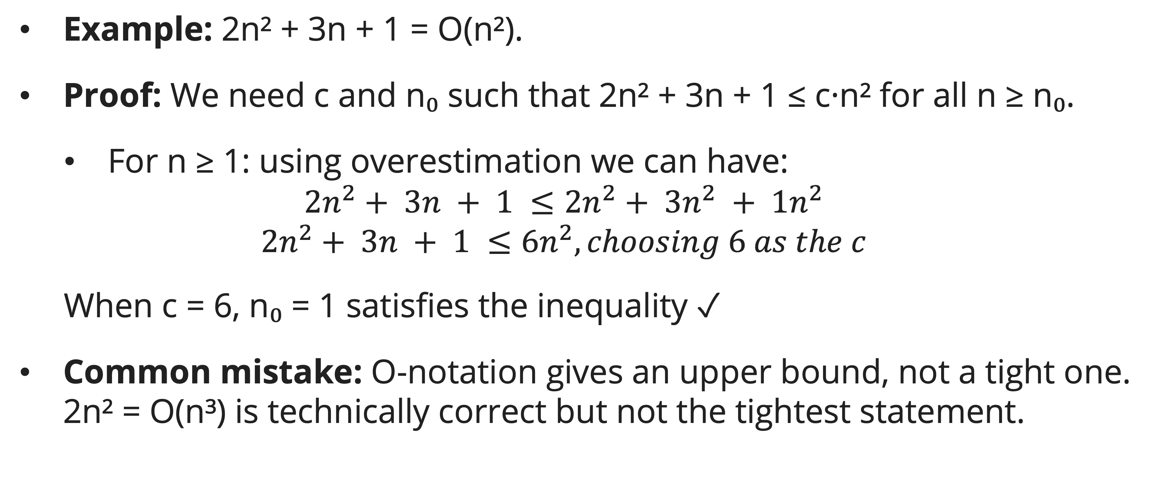
Asymptotic Notation: O, Ω, Θ
O-Notation (Asymptotic Upper Bound)
Example: 2n² + 3n + 1 = O(n²).
Proof: We need c and n₀ such that 2n² + 3n + 1 ≤ c·n² for all n ≥ n₀.
  For n ≥ 1: using overestimation we can have:
  $$2n^{2}+ 3n + 1 ≤2n^{2}+ 3n^{2} + 1n^{2}$$
  $$2n^{2}+ 3n + 1 ≤6n^{2}, choosing 6 as the c$$
  When c = 6, n₀ = 1 satisfies the inequality ✓
Common mistake: O-notation gives an upper bound, not a tight one. 2n² = O(n³) is technically correct but not the tightest statement.

Slide 7
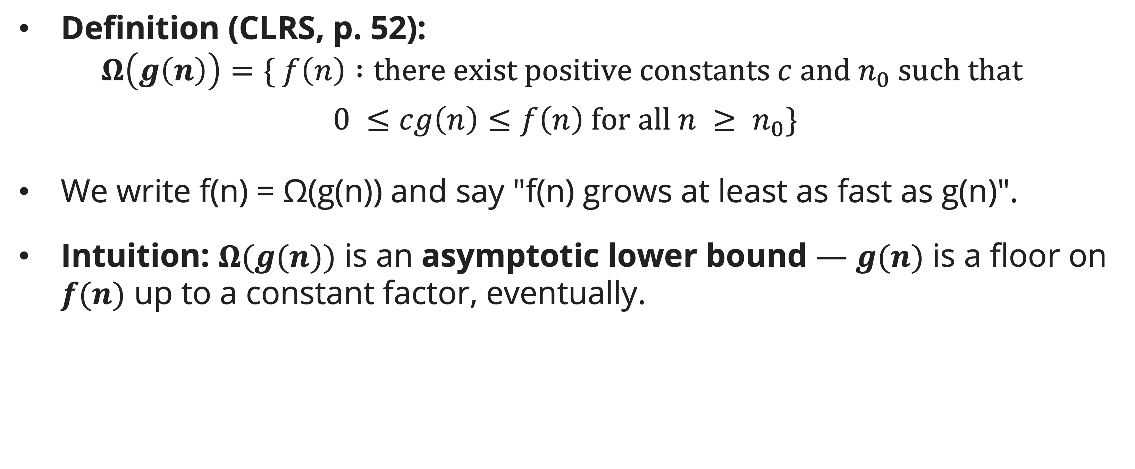
Asymptotic Notation: O, Ω, Θ
Ω-Notation (Asymptotic Lower Bound)
Definition (CLRS, p. 52):
$$Ω\left(g\left(n\right)\right)=\{ f\left(n\right) :there exist positive constants c and n_{0} such that$$
$$0 ≤cg\left(n\right)≤f\left(n\right) for all n ≥ n_{0}\}$$
We write f(n) = Ω(g(n)) and say "f(n) grows at least as fast as g(n)".
Intuition: $Ω(g(n))$ is an asymptotic lower bound — $g(n)$ is a floor on $f(n)$ up to a constant factor, eventually.

Slide 8
Asymptotic Notation: O, Ω, Θ
Ω-Notation (Asymptotic Lower Bound)
Example: 2n² + 3n + 1 = Ω(n²).
Proof: We need c and n₀ such that c·n² ≤ 2n² + 3n + 1 for all n ≥ n₀.
  In this case, it is safe to choose c = 1, as n² ≤ 2n² is always true for any real numbers.
  The term + 3n + 1 are also positive when n > 0
  When c = 1, n₀ = 1 satisfies the inequality ✓
Algorithmic use: Ω establishes lower bounds on algorithm running times and on problem difficulty. The comparison-based sorting lower bound Ω(n log n) means no comparison-based sort can beat n log n.
Notes:
Note that there are non-comparison sorting algorithms (like Counting Sort or Radix Sort) which manage to bypass this Omega(n log n) speed limit entirely

Slide 9
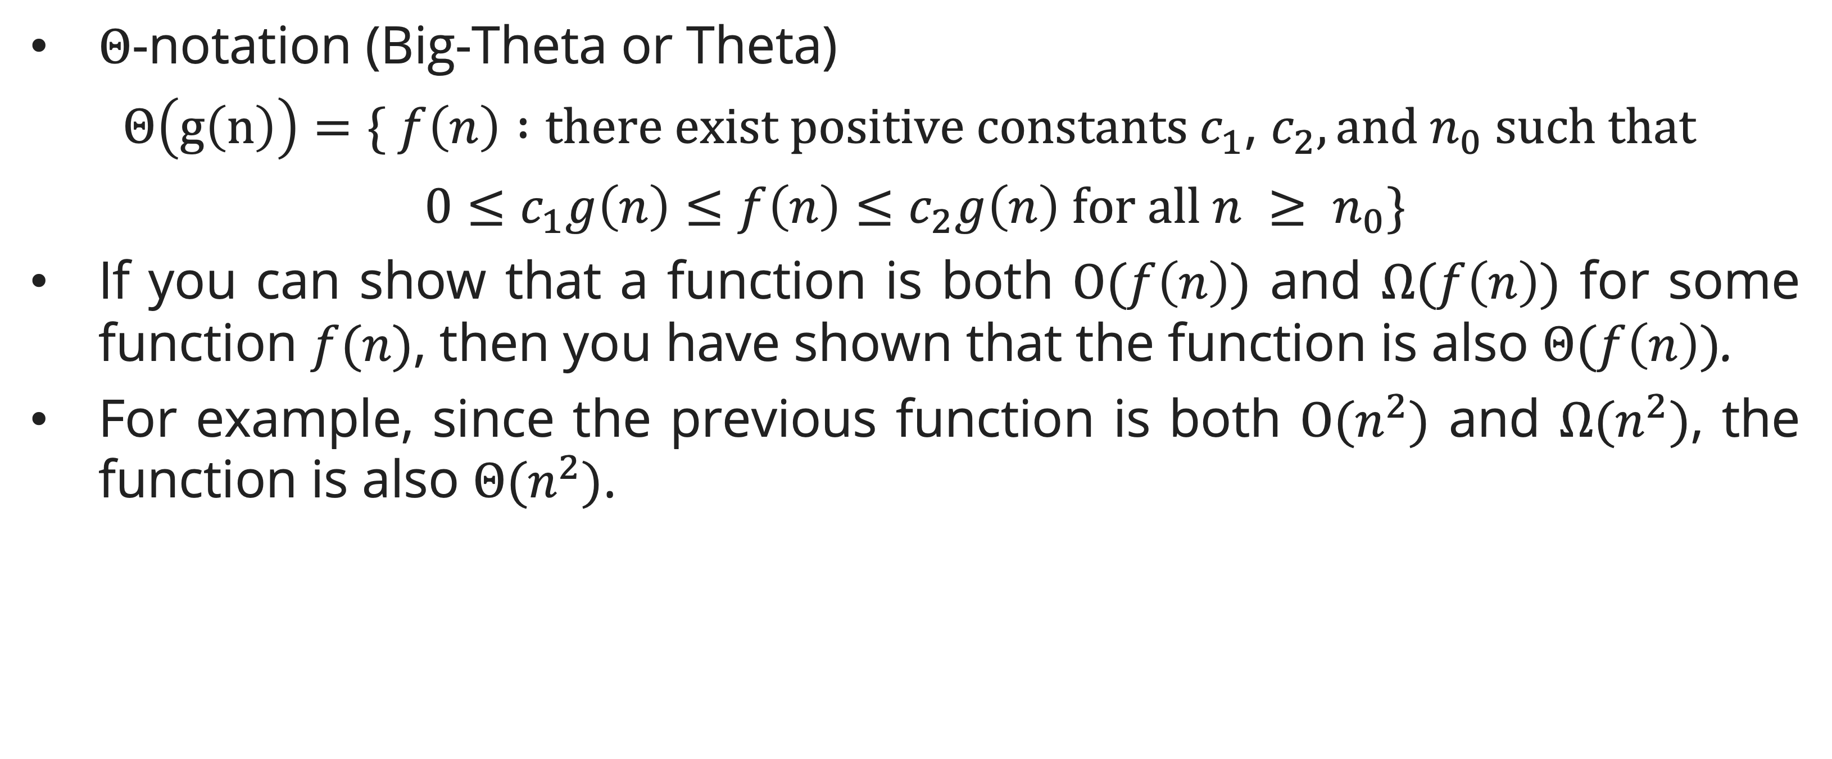
Asymptotic Notation: O, Ω, Θ
Θ-Notation (Asymptotically Tight Bound)
$Θ$-notation (Big-Theta or Theta)
$$Θ\left(g\left(n\right)\right)=\{ f\left(n\right) :there exist positive constants c_{1}\text{, }c_{2}, and n_{0} such that$$
$$0≤c_{1}g\left(n\right)≤f\left(n\right)≤c_{2}g\left(n\right) for all n ≥ n_{0}\}$$
If you can show that a function is both $Ο(f\left(n\right))$ and $Ω(f\left(n\right))$ for some function $f(n)$, then you have shown that the function is also $Θ(f\left(n\right))$.
For example, since the previous function is both $Ο(n^{2})$ and $Ω(n^{2})$, the function is also $Θ(n^{2})$.

Slide 10
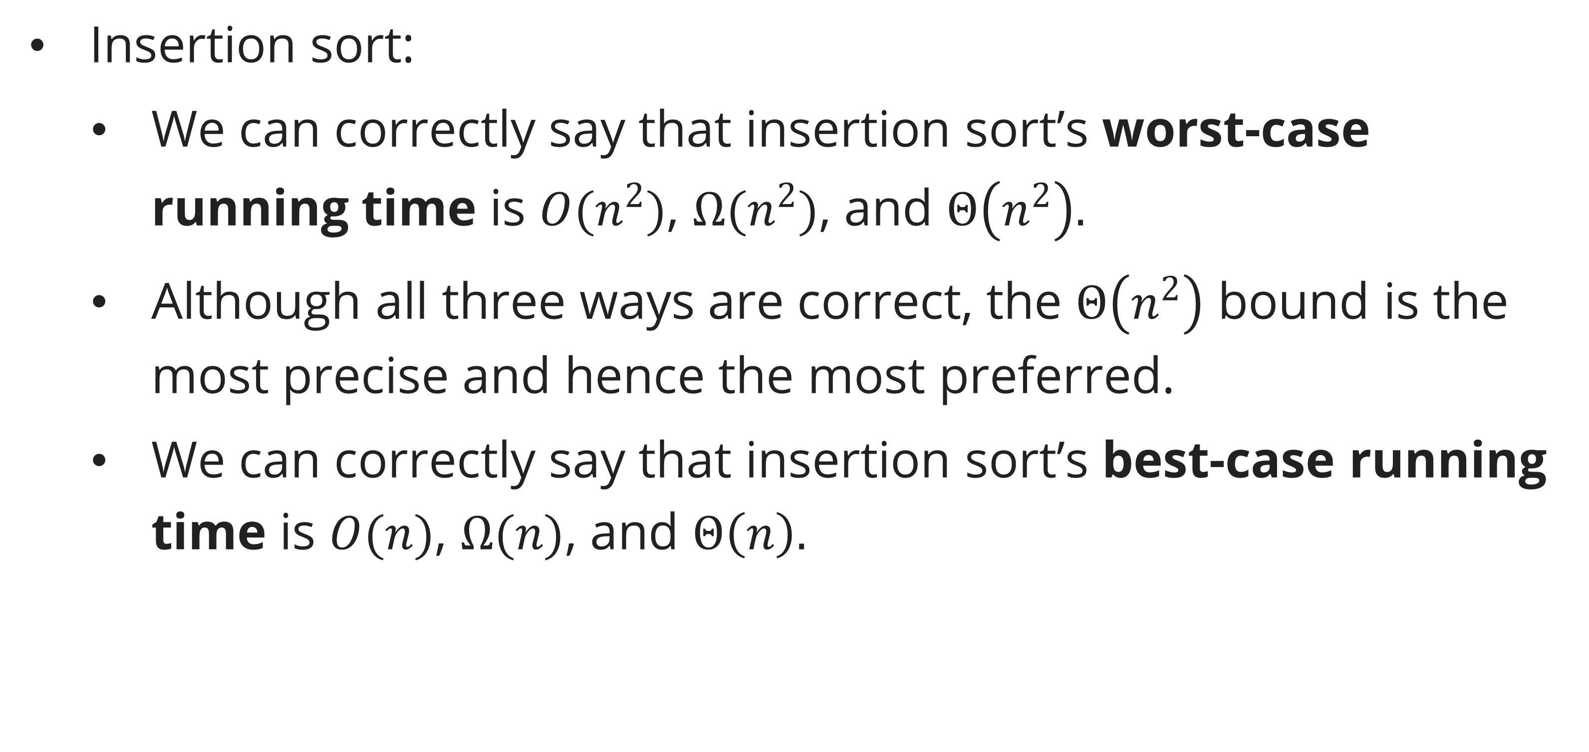
Asymptotic notation
proper use of asymptotic notations to characterize running times
Insertion sort:
  We can correctly say that insertion sort’s worst-case running time is $O(n^{2})$, $Ω(n^{2})$, and $Θ\left(n^{2}\right).$
  Although all three ways are correct, the $Θ\left(n^{2}\right)$ bound is the most precise and hence the most preferred.
  We can correctly say that insertion sort’s best-case running time is $O(n)$, $Ω(n)$, and $Θ\left(n\right).$

Slide 11
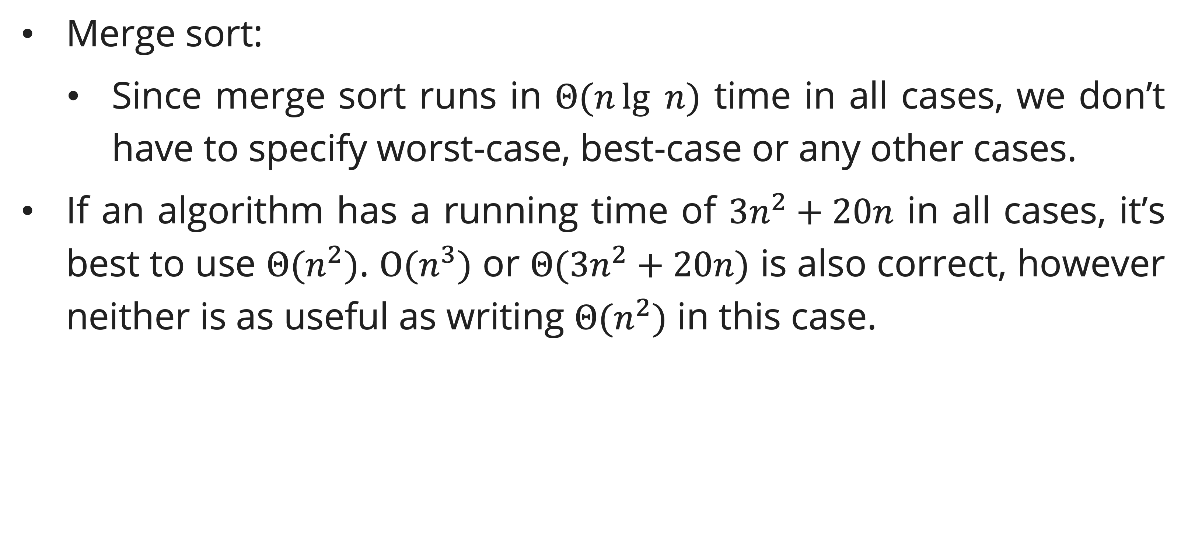
Asymptotic notation
proper use of asymptotic notations to characterize running times
Merge sort:
  Since merge sort runs in $Θ(n\lg{ n})$ time in all cases, we don’t have to specify worst-case, best-case or any other cases.
If an algorithm has a running time of $3n^{2}+20n$ in all cases, it’s best to use $Θ(n^{2})$. $O(n^{3})$ or $Θ(3n^{2}+20n)$ is also correct, however neither is as useful as writing $Θ(n^{2})$ in this case.

Slide 12
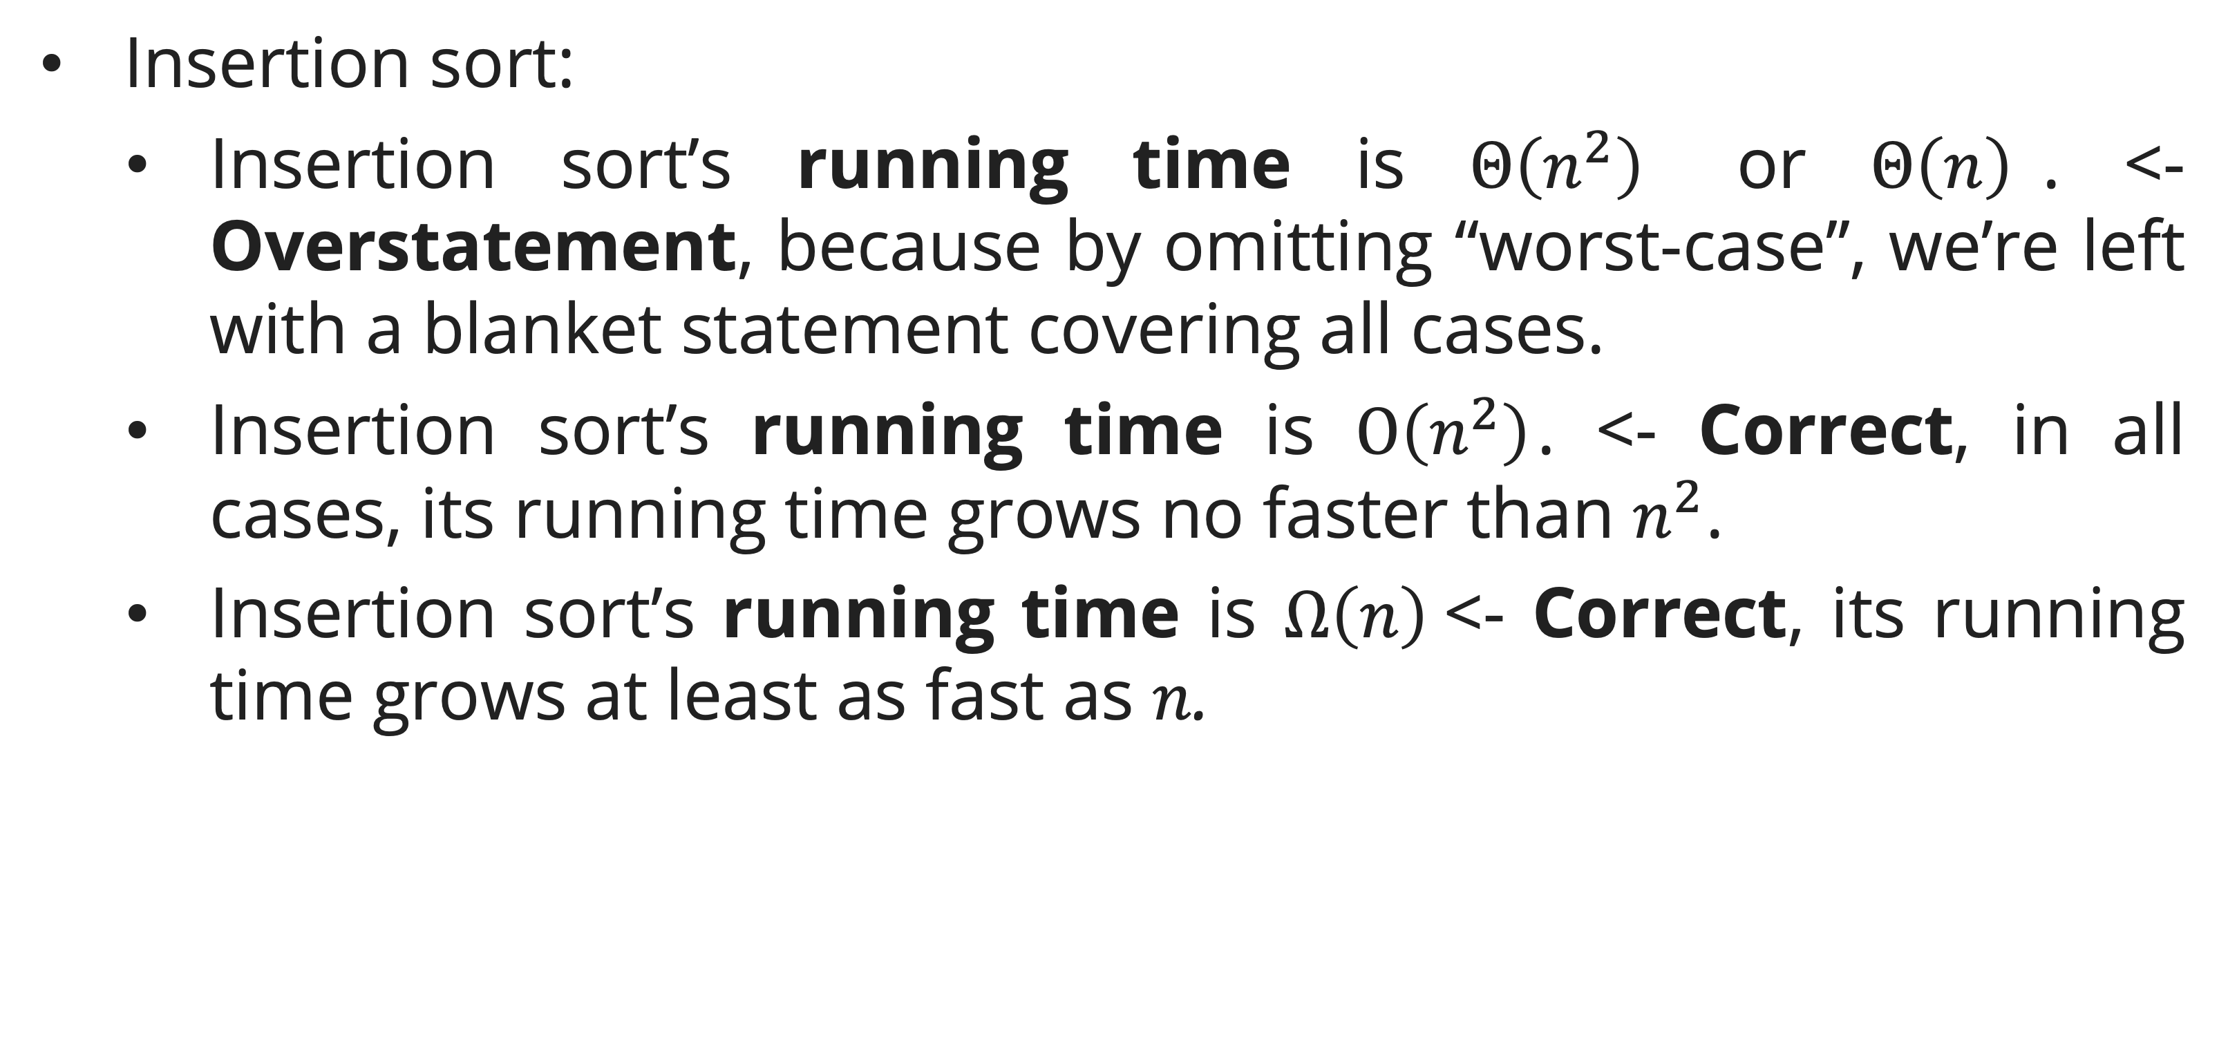
Asymptotic notation
Wrong use of asymptotic notations to characterize running times
Insertion sort:
  Insertion sort’s running time is $Θ\left(n^{2}\right)$ or $Θ\left(n\right)$. <- Overstatement, because by omitting “worst-case”, we’re left with a blanket statement covering all cases.
  Insertion sort’s running time is $O\left(n^{2}\right)$. <- Correct, in all cases, its running time grows no faster than $n^{2}$.
  Insertion sort’s running time is $Ω\left(n\right)$<- Correct, its running time grows at least as fast as $n$.

Slide 13
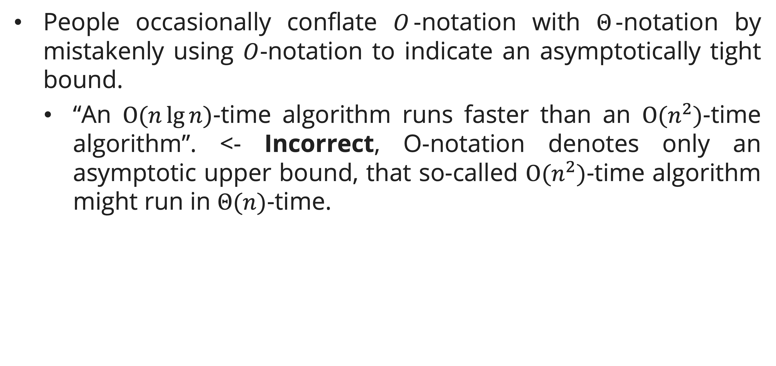
Asymptotic notation
Wrong use of asymptotic notations to characterize running times
People occasionally conflate $O$-notation with $Θ$-notation by mistakenly using $O$-notation to indicate an asymptotically tight bound.
  “An $O(n\lg{n})$-time algorithm runs faster than an $O(n^{2})$-time algorithm”. <- Incorrect, O-notation denotes only an asymptotic upper bound, that so-called $O(n^{2})$-time algorithm might run in $Θ(n)$-time.

Slide 14
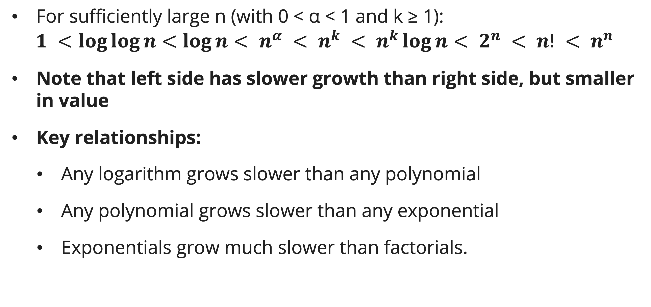
Common Functions and Their Growth Rates
Monotone Growth Hierarchy
For sufficiently large n (with 0 < α < 1 and k ≥ 1):
$$1 <\log{\log{n}}<\log{n}< n^{α} < n^{k} < n^{k}\log{n}< 2^{n} < n! < n^{n}$$
Note that left side has slower growth than right side, but smaller in value
Key relationships:
  Any logarithm grows slower than any polynomial
  Any polynomial grows slower than any exponential
  Exponentials grow much slower than factorials.

Slide 15
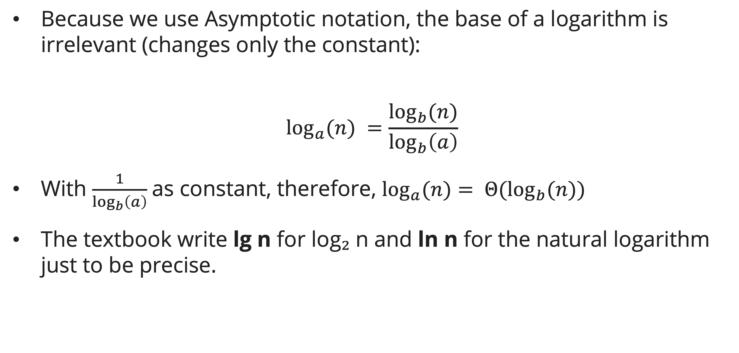
Common Functions and Their Growth Rates
Logarithm Properties
Because we use Asymptotic notation, the base of a logarithm is irrelevant (changes only the constant):
$$\log_{a}{(n)} =\frac{\log_{b}{(n)}}{\log_{b}\left(a\right)}$$
With $\frac{1}{\log_{b}\left(a\right)}$as constant, therefore, $\log_{a}{(n)}= Θ(\log_{b}{(n)})$
The textbook write lg n for log₂ n and ln n for the natural logarithm just to be precise.

Slide 16
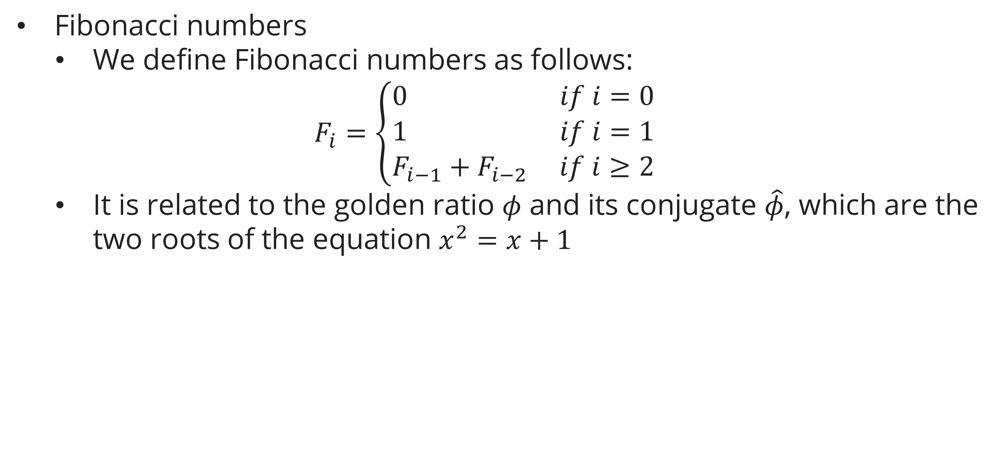
Common Functions and Their Growth Rates
Fibonacci
Fibonacci numbers
  We define Fibonacci numbers as follows:
  $$F_{i}=\left\{\begin{aligned}0 if i=0 \\ 1 if i=1 \\ F_{i−1}+F_{i−2} if i≥2\end{aligned}\right.$$
  It is related to the golden ratio $φ$ and its conjugate $\hat{φ}$, which are the two roots of the equation $x^{2}=x+1$

Slide 17
Proving Bounds Formally and Informally
Formal Proof Technique: Definition Method
To prove f(n) = O(g(n)):
  Write out the inequality f(n) ≤ c·g(n).
  Find explicit c and n₀ satisfying it.
Example: Prove 7n³ + 100n² = O(n³)
  For n ≥ 1: using overestimation we can have 100n² ≤ 100n³, so 7n³ + 100n² ≤ 107n³.
  Choose c = 107, n₀ = 1. ✓

Slide 18

Proving Bounds Formally and Informally
Informal Argument: "Drop Low-Order Terms and Constants"
For a polynomial $T(n) = aₖnᵏ + aₖ₋₁nᵏ⁻¹ + … + a₀ (aₖ > 0)$:
  $T(n) = Θ(nᵏ)$
  Justification: for $n ≥ max⁡(1, k·|aₖ₋₁/aₖ|, …)$, the leading term dominates.

Slide 19
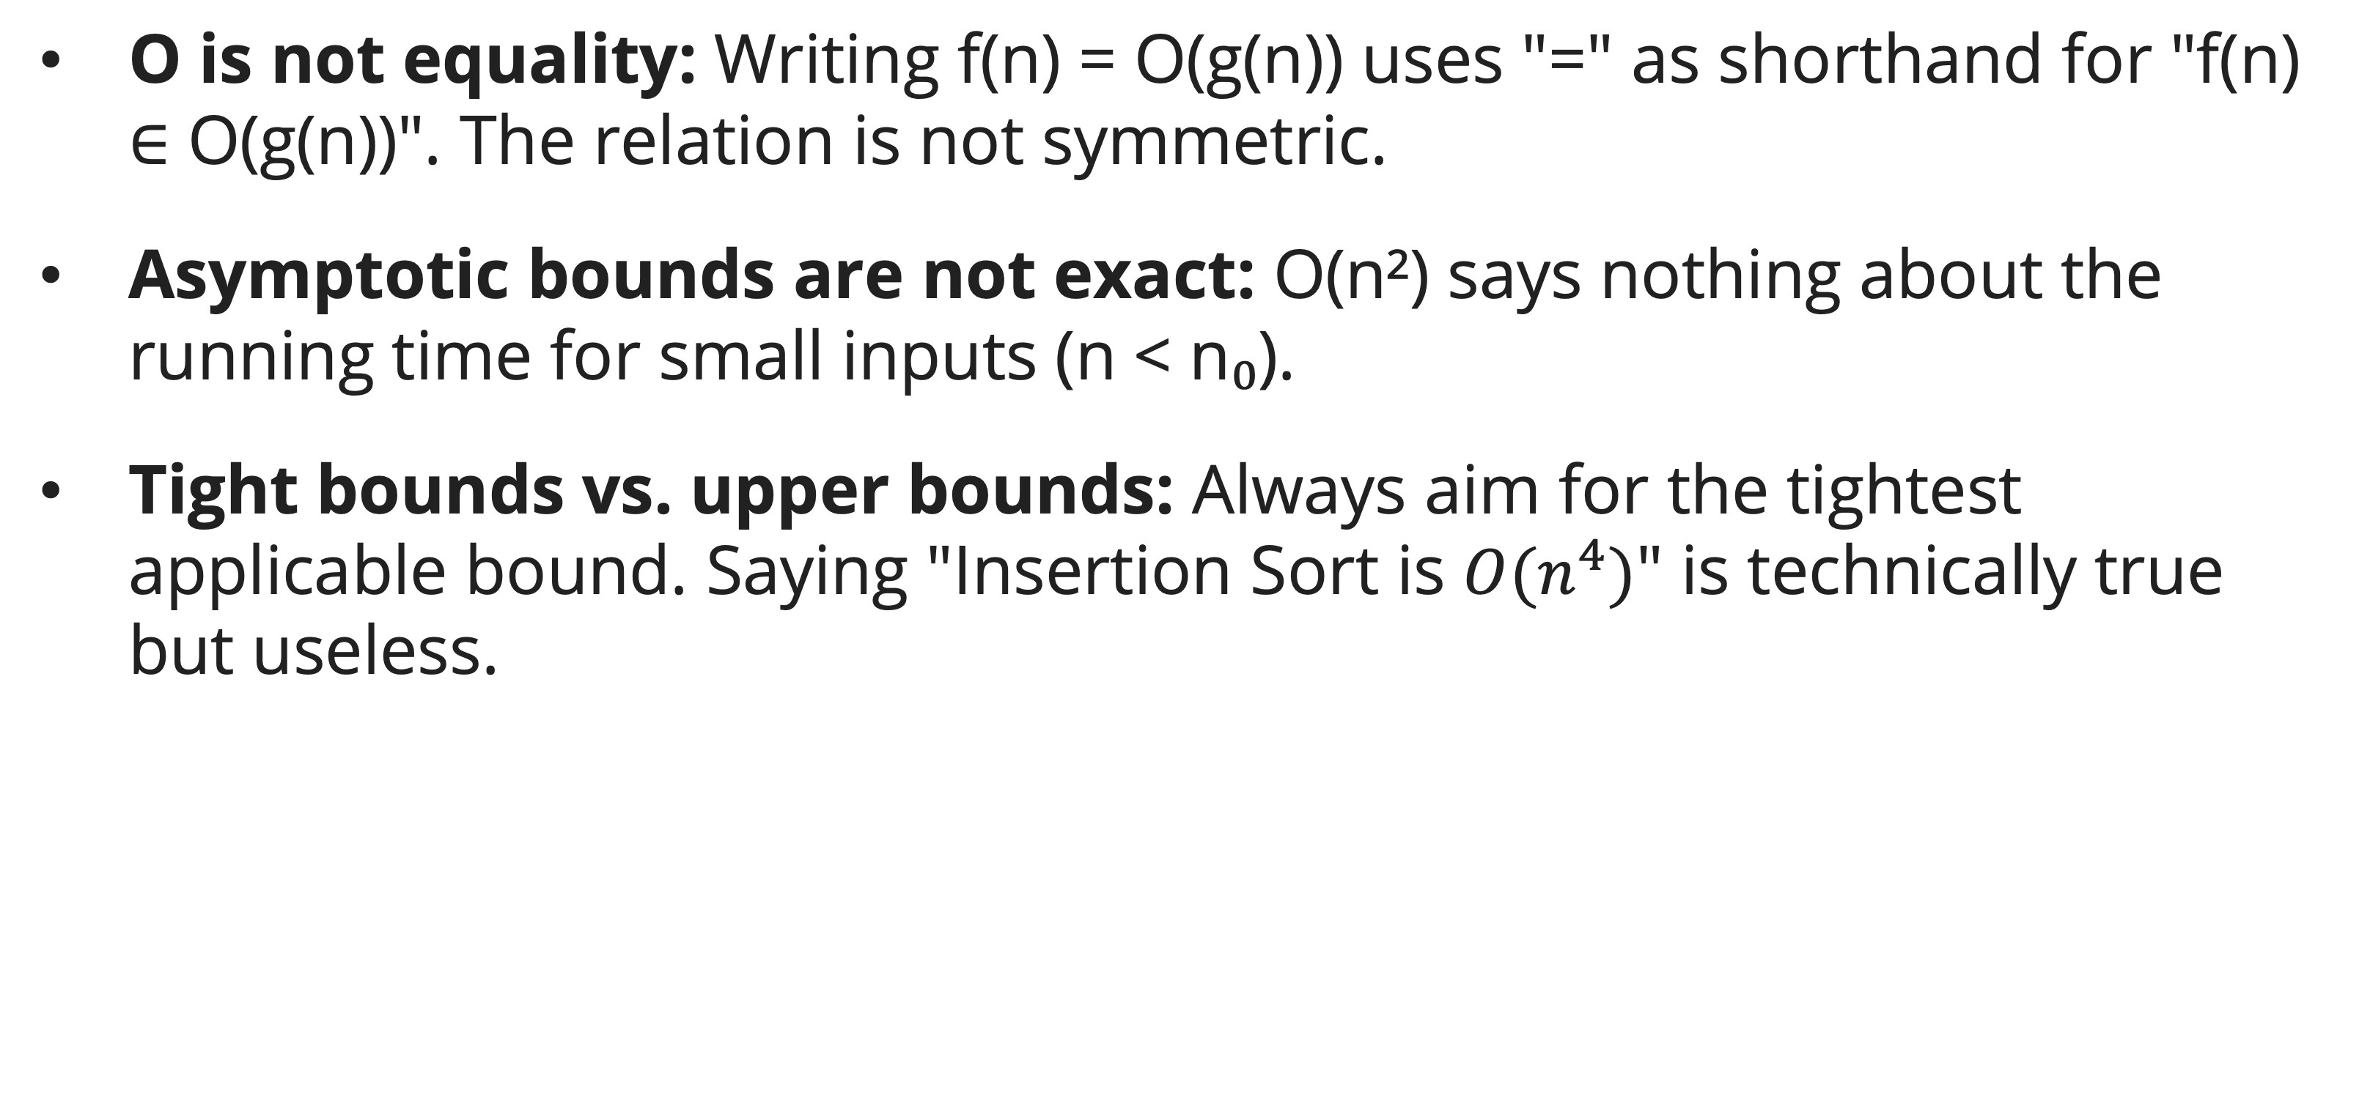
Proving Bounds Formally and Informally
Common Pitfalls
O is not equality: Writing f(n) = O(g(n)) uses "=" as shorthand for "f(n) ∈ O(g(n))". The relation is not symmetric.
Asymptotic bounds are not exact: O(n²) says nothing about the running time for small inputs (n < n₀).
Tight bounds vs. upper bounds: Always aim for the tightest applicable bound. Saying "Insertion Sort is $O(n^{4})$" is technically true but useless.

Slide 20
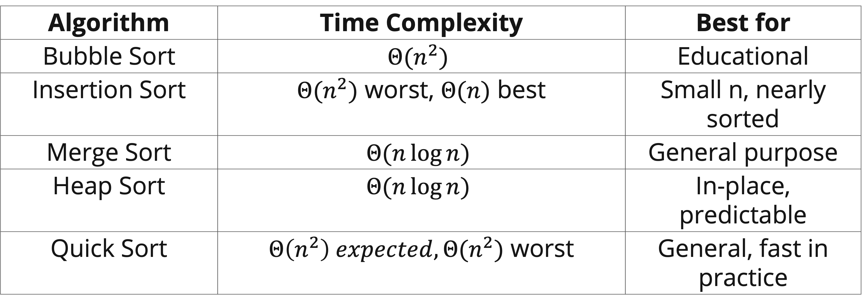
Comparing Algorithm Efficiency
Using Asymptotic Notation to Choose Algorithms
Here is some ways to choose sorting algorithms:
Algorithm | Time Complexity | Best for
Bubble Sort | $$Θ(n^{2})$$ | Educational
Insertion Sort | $Θ(n^{2})$ worst, $Θ(n)$ best | Small n, nearly sorted
Merge Sort | $$Θ(n\log{n})$$ | General purpose
Heap Sort | $$Θ(n\log{n})$$ | In-place, predictable
Quick Sort | $Θ\left(n^{2}\right) expected, Θ(n^{2})$ worst | General, fast in practice

Slide 21
Comparing Algorithm Efficiency
General Practical Guidance
For n < 50: constant factors dominate; insertion sort is often fastest in practice.
For n up to 10⁴: O(n²) may be acceptable.
For n > 10⁶: O(n log n) or better is typically required.
For n > 10⁸: O(n) algorithms are preferred.

Slide 22
Comparing Algorithm Efficiency
Space Complexity and the Time-Space Tradeoff
In-place: O(1) additional space (e.g., insertion sort, heapsort).
Not in-place: O(n) additional space (e.g., merge sort).
Hash tables: O(n) space, O(1) average lookup — classic time-space tradeoff.
Often we can reduce time by spending more space (memoization, hash tables) or reduce space by spending more time (recomputing instead of caching).

Slide 23
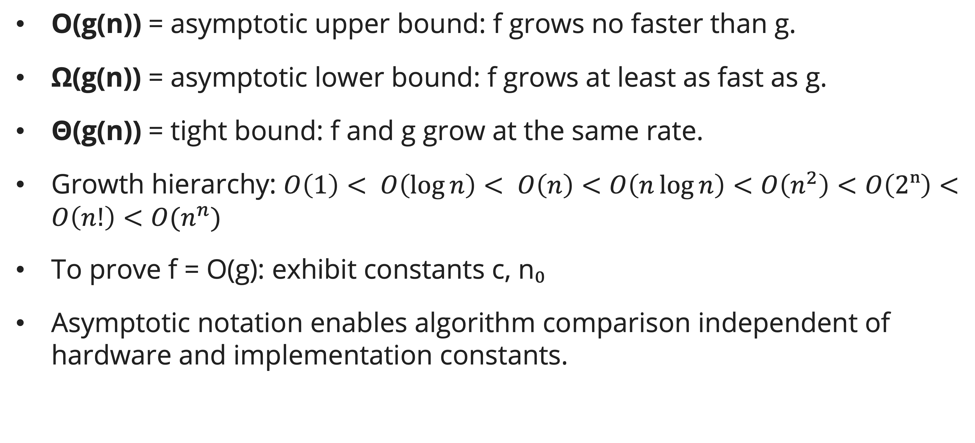
Summary
Session 4
O(g(n)) = asymptotic upper bound: f grows no faster than g.
Ω(g(n)) = asymptotic lower bound: f grows at least as fast as g.
Θ(g(n)) = tight bound: f and g grow at the same rate.
Growth hierarchy: $O\left(1\right)< O\left(\log{n}\right)< O\left(n\right)<O\left(n\log{n}\right)<O\left(n^{2}\right)<O\left(2ⁿ\right)<O\left(n!\right)<O(n^{n})$
To prove f = O(g): exhibit constants c, n₀
Asymptotic notation enables algorithm comparison independent of hardware and implementation constants.

Slide 24

Exercises
General exercises
Prove from the definition that 5n² + 10n = Θ(n²). Provide explicit c₁, c₂, and n₀.
Is $2^{n+1} = O(2^{n})$? Is $2^{2n} = O(2^{n})$? Justify using prove by definition
Rank the following from slowest to fastest asymptotic growth: $n!, 2^{n}, n^{3}, n\log{n,}\sqrt{n},\log^{2}{n}$.

Slide 25
Exercises
Guess the running time of these procedures
procedure SampleProgram1(n, c) // c > 0 is a constant
i = n
while i > 0 do
CONSTANT_WORK()
i = i - c
end while
end procedure
procedure SampleProgram2(n, c) // c > 1 is a constant
i = 1
while i < n do
CONSTANT_WORK()
i = i * c
end while
end procedure

Slide 26
Exercises
Guess the running time of these procedures
procedure SampleProgram3(n)
for i = 0 to n-1 do
j = 1
while j < n do
CONSTANT_WORK()
j = j * 2
end while
end for
end procedure

Slide 27
Exercises
Guess the running time of these procedures
procedure SampleProgram4(n)
// Loop A: runs n times
for i = 0 to n-1 do
CONSTANT_WORK()
end for
// Loop B: i triples each time
i = 1
while i < n do
CONSTANT_WORK()
i = i * 3
end while
// Loop C: fixed number of iterations
for i = 1 to 999 do
CONSTANT_WORK()
end for
end procedure

Slide 28
Exercises
Guess the running time of these procedures
procedure SampleProgram5(n)
// Block 1: inner j multiplies by 3
for i = 0 to n-1 do
j = 1
while j < n do
CONSTANT_WORK()
j ← j * 3
end while
end for
// Block 2: inner j increments by 1
for i = 0 to n-1 do
for j = 2 to n-1 do
CONSTANT_WORK()
end for
end for
end procedure

Slide 29
Exercises
Guess the running time of these procedures
procedure SampleProgram6(n, m)
// Block for n: inner j multiplies by 3
for i = 0 to n-1 do
j = 1
while j < n do
CONSTANT_WORK()
j ← j * 3
end while
end for
// Block for m: inner j increments by 1
for i = 0 to m-1 do
for j = 1 to m-1 do
CONSTANT_WORK()
end for
end for
end procedure

Slide 30
References
Session 4
Cormen, T.H., Leiserson, C.E., Rivest, R.L., & Stein, C. (2022). Introduction to Algorithms, 4th Edition. MIT Press. Ch. 3.1 – 3.3
Skiena, S.S. (2020). The Algorithm Design Manual, 3rd Edition. Springer. Ch. 2.2 - 2.4

